Slide 1
INNER-CITY MUSLIM ACTION NETWORK — ENGLEWOOD 2040
The Englewood Question
Why a 30-year life expectancy gap exists, why it hasn’t closed,
and what would actually move it.
Chicago, IL • April 2026 • Evidence-based briefing
90
67.7
− 22.3
Life expectancy, Streeterville
Life expectancy, Englewood
Years of life, same city

Slide 2
22 years of life, in the same city
02 / 18
THE ONE SENTENCE
The gap is not new. It has been measured by a different name in every generation
“health disparities” in the 1980s, “structural racism” in the 2000s, “social determinants of health” today. The label rotates.
The number has moved very little.
LIFE EXPECTANCY BY CHICAGO TRACT
Streeterville
90.0
Lincoln Park
85.1
Hyde Park
80.4
Chicago average
77.3
Little Village
82.0
Chicago Lawn
73.9
Englewood
67.7
IMAN 2040 • Investor Brief • April 2026

Slide 3
Two decades of programs. A neighborhood that hasn’t moved.
03 / 18
THE COMPLICATION
Englewood has been a destination for programs. Grocery stores have opened. Clinics have expanded. Violence-interruption crews have patrolled. Some of these programs have been excellent — and rigorously evaluated. And yet Englewood’s life expectancy has barely budged.
BARBERSHOP BP PROGRAM
CURE VIOLENCE / READI
HEALTH-CENTER EXPANSION
−27 mmHg
−50%
+1.5 yr
systolic blood pressure reduction
serious violence over 18 months
life expectancy in service area
LA / Cedars-Sinai RCT
Chicago West Side
FQHC panel evidence
The programs work. The neighborhood does not change. Life expectancy is a neighborhood outcome, not a program outcome.
IMAN 2040 • Investor Brief • April 2026

Slide 4
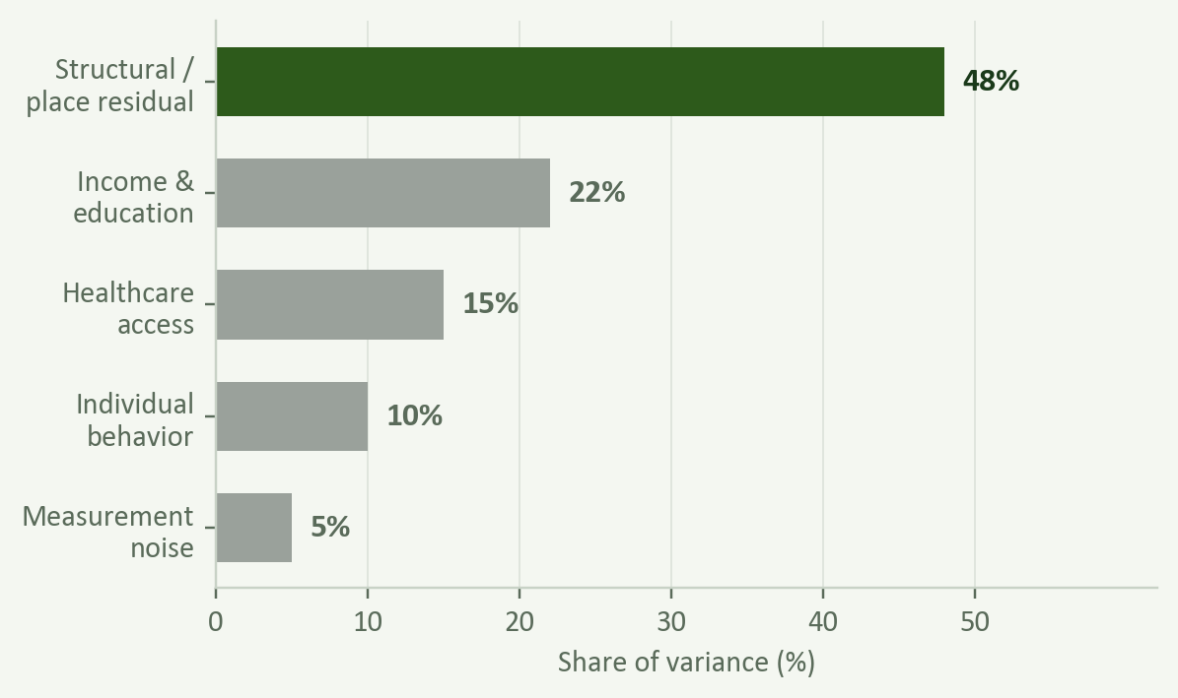
The remaining variance is about place, not behavior
04 / 18
WHAT THE DATA ACTUALLY SAYS
Hold behavior constant. The gap is still there.
Hold income constant. The gap is still there.
Hold education and insurance constant. The gap shrinks but doesn’t close.
Roughly half of tract-level life-expectancy variance in the U.S. is structural / place-based — not individual behavior, not healthcare access, not income alone. That is the share IMAN is set up to move.
Decomposition of tract-level life-expectancy variance, pooled U.S. data (CDC USALEEP; peer-reviewed models, 2018–2024).
IMAN 2040 • Investor Brief • April 2026

Slide 5
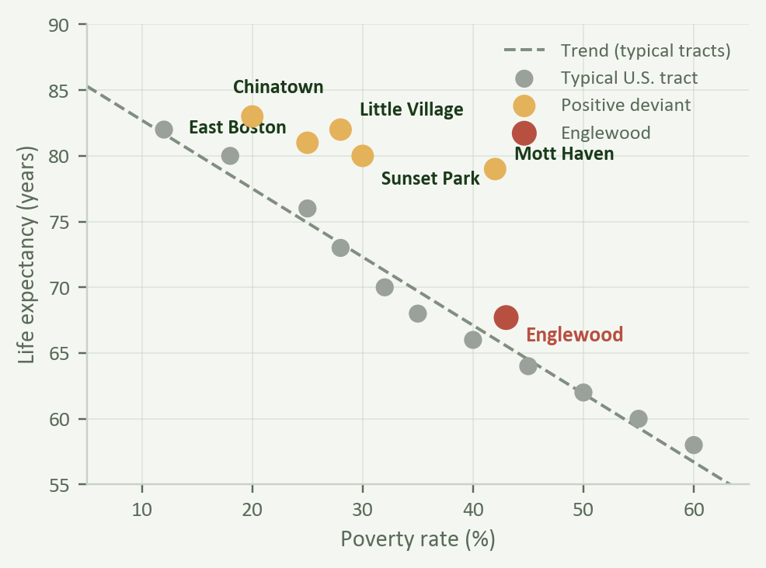
Some poor neighborhoods outlive their demographics by a decade
05 / 18
POSITIVE DEVIANTS
Each dot is a U.S. census tract.
The dashed line is what the model predicts given poverty rate.
The amber dots — Little Village, East Boston, Sunset Park, Chinatown — sit 10–15 years above their predicted line. They are poor. They are dense. They are non-white. Their people live longer than the model predicts.
Englewood (red) sits roughly on the line. The deviants prove the gap is not fate.
IMAN 2040 • Investor Brief • April 2026

Slide 6
The feature in common is not a program. It’s a form.
06 / 18
COLLECTIVE EFFICACY — SAMPSON, 25 YEARS OF EVIDENCE
Walkable streets
Three-generation households
Anchor institutions
Dense networks
Daily pedestrian encounters outrank gym membership as a cardiovascular predictor.
Social support that hospitals price at $30K / yr per chronic-disease patient. Free, if it exists.
A mosque, church, market, school, or cultural center that residents encounter daily.
People who know each other’s children’s names — the single most consistent non-behavioral predictor of who lives and dies.
IMAN’s goal is not to import clinical interventions into Englewood. It is to manufacture the structural features of a naturally long-lived poor neighborhood around the people who already live there.
IMAN 2040 • Investor Brief • April 2026

Slide 7
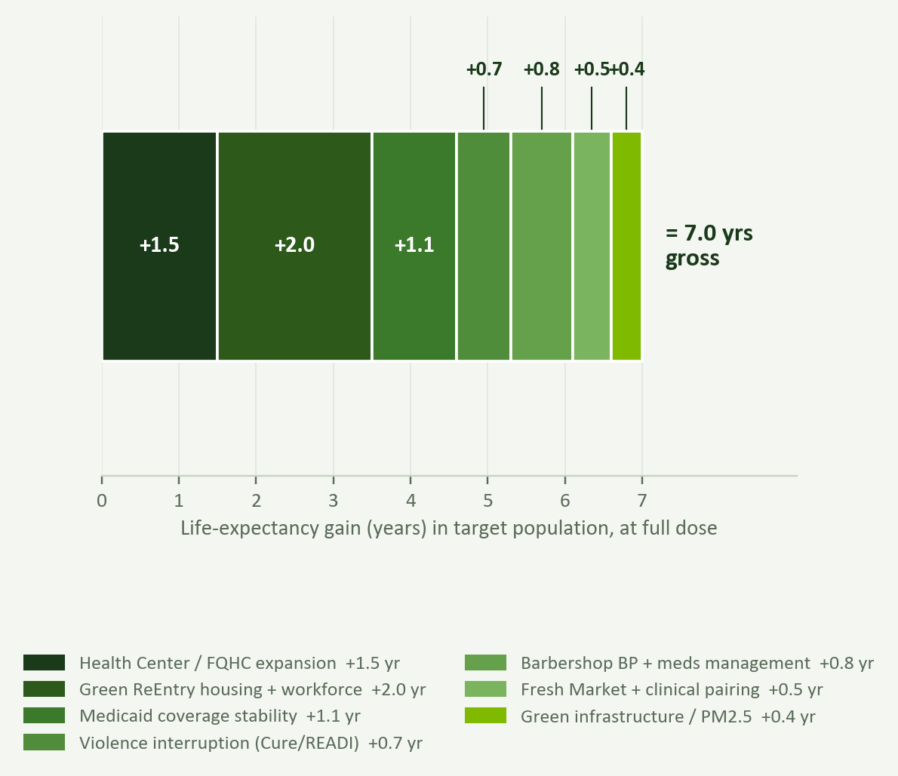
Single programs move inches. Stacked ecosystems move years.
07 / 18
THE STACKED-INTERVENTION THESIS
At full dose in the target population:
~7 years gross LE gain,
summed across IMAN’s seven pillars.
Net — after overlap, attrition, selection — the defensible projection is 3–5 years over 10–15 years in a majority-Black neighborhood at full build-out.
Dudley Street, East Lake, Purpose Built — wherever the stack has been run, effects compounded non-linearly. Adjacent programs reinforce each other’s retention and dose.
IMAN 2040 • Investor Brief • April 2026

Slide 8
Same city. Same hospitals. Same mayor. 22 years apart.
08 / 18
CHICAGO, AT TRACT RESOLUTION
THE GAP IS ROBUST TO ADJUSTMENT
YEARS OF LIFE EXPECTANCY
90.0
Raw crude gap
22.3 yr
67.7
− poverty rate
14.1 yr
− income + education
10.8 yr
− insurance coverage
9.4 yr
− race / ethnicity
8.1 yr
− all of the above
≈ 5 yr unexplained
Streeterville
Englewood
a 22.3-year gap, 3 miles apart
Even after every statistical adjustment, about 5 years of gap remain. That residual is structural.
IMAN 2040 • Investor Brief • April 2026

Slide 9
IMAN already operates a full-ecosystem footprint in Englewood
09 / 18
WHAT IS ALREADY ON THE GROUND
IMAN Health Center
Fresh Beat / Fresh Market
Green ReEntry
10,000+ patients; primary care, behavioral health, addiction medicine.
Halal grocery + corner-store conversions on 63rd Street corridor.
Housing rehab + construction workforce for returning citizens.
Arts & Culture
Community Organizing
Regenerator / Policy
Griot Plaza, open-air venues, cultural programming as civic anchor.
Weekly civic formation; leadership pipelines from Chicago Lawn to Englewood.
Civic-tech platform connecting residents to benefits, jobs, services.
The 2040 ask is not to start — it is to intensify, to the density at which stacked effects appear.
IMAN 2040 • Investor Brief • April 2026

Slide 10
Health Center expansion
10 / 18
PILLAR 1 — CLINICAL BASE
PILLAR 1 — AT FULL DOSE
WHAT IMAN ACTUALLY DOES
+1.5
Expand to 20,000 primary-care patients on the South Side.
Integrate behavioral health, addiction medicine, pharmacy on-site.
Embedded chronic-disease coaching: BP, A1c, lipid management.
years of LE gain in the FQHC service area at full panel penetration.
Link every intake to food-access, housing, and workforce referrals.
FQHC evidence panel (HRSA / NEJM, 2016–2024).
Full-panel FQHC evidence sits at +1.5 yr of LE gain — the anchor of the ecosystem.
IMAN 2040 • Investor Brief • April 2026

Slide 11
Green ReEntry — housing plus workforce
11 / 18
PILLAR 2 — STRUCTURAL
PILLAR 2 — AT FULL DOSE
WHAT IMAN ACTUALLY DOES
+2.0
Rehab 250 vacant homes in Englewood / Chicago Lawn over 10 years.
Construction workforce staffed from returning-citizen cohort.
Living-wage jobs that build the neighborhood they live in.
years of LE gain in the housed-and-employed cohort (Dudley Street analog).
Housing stability eliminates the chief driver of missed-care cycles.
Dudley Street Neighborhood Initiative; returning-citizen housing RCTs.
Housing + income stability is the single largest structural lever in the stack.
IMAN 2040 • Investor Brief • April 2026

Slide 12
Fresh Market + clinical coaching
12 / 18
PILLAR 3 — FOOD ACCESS DONE RIGHT
PILLAR 3 — AT FULL DOSE
WHAT IMAN ACTUALLY DOES
+0.5
Halal grocery + corner-store conversions across 63rd Street.
Produce prescriptions paired with Health Center coaching.
Fresh Beat SNAP-match: subsidized purchases tied to appointments.
years of LE gain — contingent on clinical wraparound.
NOTE: produce prescriptions alone have ~zero effect — IMAN’s model pairs them with clinical dose.
Philadelphia Healthy Corner Store; 2026 produce-Rx pooled trials.
Food access only moves outcomes when bundled with the clinical pillar. IMAN’s model is bundled.
IMAN 2040 • Investor Brief • April 2026

Slide 13
Violence interruption
13 / 18
PILLAR 4 — COMMUNITY SAFETY
PILLAR 4 — AT FULL DOSE
WHAT IMAN ACTUALLY DOES
+0.7
Formal partnership with Cure Violence / READI Chicago.
Hire 8–12 interrupters from the Green ReEntry pool.
Weekly shooting reviews with Health Center behavioral-health team.
years of LE gain in young-adult men at READI-level dose.
Three-year minimum funding commitment — shorter cycles erase the effect.
Cure Violence RCTs; READI Chicago evaluation (UChicago, 2022–2024).
READI-dose violence interruption cuts serious violence 40–65% — the clearest causal effect in the stack.
IMAN 2040 • Investor Brief • April 2026

Slide 14
Barbershop blood-pressure program
14 / 18
PILLAR 5 — CARDIOVASCULAR BEACHHEAD
PILLAR 5 — AT FULL DOSE
WHAT IMAN ACTUALLY DOES
+0.8
Deploy in 8–10 Black-owned barbershops on 63rd & Halsted.
IMAN pharmacist prescribes in-shop; barbers screen during cuts.
$25 voucher per completed visit drives repeat adherence.
years of LE gain in the Black-male population at full reach.
64% reach BP control vs. 12% in usual care (Cedars-Sinai RCT).
Victor et al., NEJM 2018; replication studies 2021–2024.
One of the largest treatment effects ever measured in cardiology. Deployable in year 1.
IMAN 2040 • Investor Brief • April 2026

Slide 15
Griot Plaza and community organizing
15 / 18
PILLAR 6 — THE COLLECTIVE-EFFICACY PILLAR
PILLAR 6 — AT FULL DOSE
WHAT IMAN ACTUALLY DOES
×
Open-air plaza + performance venue as daily neighborhood anchor.
Weekly civic formation: leadership pipelines, youth programming.
Arts programming that brings 20,000+ residents through the block/yr.
this pillar is the multiplier that makes the other five compound, rather than stack arithmetically.
Mosque + Health Center + Plaza + Market together = the anchoring ecology Sampson documents.
Sampson, Great American City; 25 years of Chicago PHDCN data.
There is no “program” for collective efficacy — only the cumulative effect of dense, durable institutions.
IMAN 2040 • Investor Brief • April 2026

Slide 16
What to promise — and what not to
16 / 18
THE DEFENSIBLE PROJECTION
AT FULL BUILD-OUT, OVER 10–15 YEARS
3 to 5 years of life-expectancy gain in a majority-Black neighborhood.
WHY NOT MORE
WHY NOT LESS
7–10 year numbers come from immigrant enclaves whose longevity reflects culturally-bounded diet, immigration selection, and the ‘returning-home’ effect that statistically inflates measured longevity. Structural features transfer. Demographic tailwinds do not.
Stacked-intervention literature, adjacent evidence from Little Village, and dose-response curves from every single-intervention RCT point in the same direction. 3–5 years is the floor of the defensible range, not a ceiling.
IMAN 2040 • Investor Brief • April 2026

Slide 17
Three nested layers. Three audiences. One number that matters.
17 / 18
HOW WE WILL KNOW
QUARTERLY DASHBOARD
SYNTHETIC CONTROL
LE RESIDUAL
FOR THE BOARD
FOR FUNDERS
FOR THE HISTORICAL RECORD
BP control, ED visits for ambulatory-care-sensitive conditions, fresh-produce share of Fresh Market sales, housing placements, monthly homicides & shootings in the service area.
From 2028: is Englewood diverging from its 16 peer communities (South Side Chicago, West Detroit, Memphis, Jackson, East St. Louis, Flint, Youngstown, …)? Direction + magnitude of divergence separates IMAN from macro drift.
When the successor to USALEEP ships (≈2030): did Englewood’s actual life expectancy end up higher than its poverty, race, insurance, and unemployment profile predicted? That is the number the work will be remembered by.
moves in months
moves in years
moves in a decade
Leading indicators every quarter. Lagging outcome once a decade. The board doesn’t wait for the historical record.
IMAN 2040 • Investor Brief • April 2026

Slide 18
THE ASK
$25M
catalytic capital to intensify the ecosystem to stacked-evidence density.
Fund the ecosystem, not the program.
Give it ten to fifteen years, not three.
Measure the lagging outcome, but watch the leading indicators every quarter.
Compare Englewood to the communities it actually resembles.
Inner-City Muslim Action Network • Englewood, Chicago • April 2026

